Slide 1


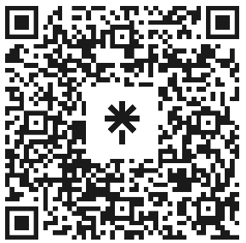

Welcome to Code Crunch!
C8|Crunch Labs: Web Dev
THU 3-4PM Weekly | Spring 2025
Attendance
Earn a Certificate of Completion by attending at least 70% of the workshops
linktr.ee/CODE.CRUNCH

Slide 2
Week #4
Understanding JavaScript Fundamentals and the Document Object Model (DOM)

Slide 3
Introduction to the Week’s Topic
Overview: In this lesson, we will dive into JavaScript, one of the core languages for web development. We’ll cover the basics of JavaScript syntax, variables, data types, and functions. We’ll also be introducing the Document Object Model (DOM) and how JavaScript interacts with it.
Real-World Relevance:
JavaScript powers much of the interactivity on modern websites.
Through JavaScript and DOM manipulation, we can make dynamic web pages that respond to user actions, such as clicks, form submissions, and more.

Slide 4
Key Concepts for Today’s Lecture
Concepts Covered:
JavaScript fundamentals: variables, data types, and functions.
Introduction to the Document Object Model (DOM).
DOM manipulation for interactivity.

Slide 5
Introduction to JavaScript
What is JavaScript?
JavaScript is a programming language used to add interactivity and dynamic behavior to websites.
It runs in the browser and allows developers to manipulate elements on the webpage in real time.
It is often used for tasks like form validation, event handling, animations, and fetching data from external sources.

Slide 6
JavaScript Syntax and Structure
Basic Syntax:
JavaScript is a case-sensitive language, so variable names and function names must be written consistently.
Code is executed line by line from top to bottom.
Comments:
Single-line comments: // This is a comment
Multi-line comments: /* This is a multi-line comment */

Slide 7
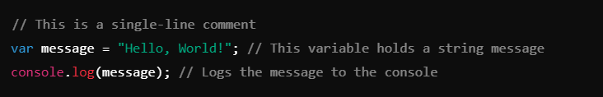

Slide 8
Variables and Data Types
Variables in JavaScript:
Variables store data that can be referenced and manipulated in a program.
Use var, let, or const to declare variables.
var: Older method (use cautiously).
let: Declares a block-scoped variable.
const: Declares a block-scoped variable that cannot be reassigned.
Data Types:
String: Represents text data.
Number: Represents numeric values.
Boolean: Represents true or false.
Array: Represents a list of values.
Object: Represents a collection of key-value pairs.

Slide 9
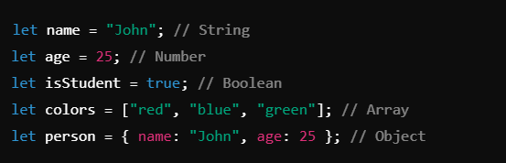

Slide 10
Functions in JavaScript
What is a Function?
A function is a block of code designed to perform a particular task. Functions help to organize and reuse code.
Defining a Function:
Use the function keyword to define a function.
Functions can take inputs (parameters) and return outputs (return values).

Slide 11
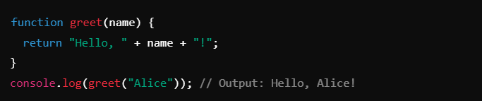
Parameters and Arguments:
A function can accept parameters (inputs) that are used inside the function.
When calling the function, you provide arguments for those parameters.

Slide 12
Introduction to the Document Object Model (DOM)
What is the DOM?
The Document Object Model (DOM) represents the structure of an HTML document as an object tree.
JavaScript can be used to manipulate the DOM to add interactivity and dynamically change the content of a webpage.
DOM Structure:
The DOM is structured in a tree format with the root element (<html>) at the top and various child nodes (e.g., <head>, <body>, and all other HTML elements).
Each element, attribute, and piece of text in the document is represented as a node in the DOM tree.

Slide 13
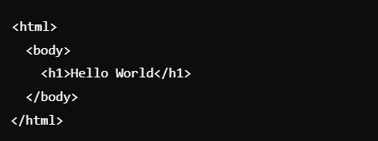

Slide 14
Accessing DOM Elements with JavaScript
How to Access DOM Elements:
You can access DOM elements using JavaScript through methods like getElementById(), getElementsByClassName(), or querySelector().

Slide 15

getElementById():
Accesses an element by its unique ID.
querySelector():
Accesses the first element that matches a CSS selector.

Slide 16
Manipulating DOM Elements

Slide 17

Changing Content | Use .innerHTML or .textContent to change the content of elements.

Slide 18

Changing Styles | Use .style to modify the styles of an element dynamically.

Slide 19
Event Handling in JavaScript
Event Listeners:
JavaScript can be used to listen for user interactions, such as clicks, key presses, etc.
Use .addEventListener() to attach events to DOM elements.

Slide 20
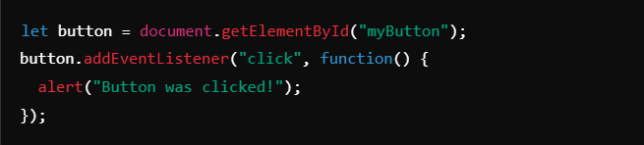

Slide 21
Summary of Key Points
JavaScript Basics: Variables, data types, and functions are the building blocks of JavaScript.
DOM Manipulation: JavaScript enables you to dynamically interact with and modify the content and structure of your web page using the DOM.
Event Handling: You can capture user interactions like clicks and apply dynamic changes to the page.

Slide 22
Coding Lab

Slide 23
Introduction to the Coding Lab
Objective: In this lab, you will use JavaScript to add interactivity to your website. You will manipulate the DOM to update content, styles, and handle user input.
Skills Covered:
Accessing and modifying DOM elements.
Adding event listeners for interactivity.
Using JavaScript functions to handle dynamic changes.

Slide 24

Step 2: Create a new file named script.js and link it to your index.html file.

Slide 25
Task 1 - Change Text Content Dynamically

Slide 26

Add an HTML element with an ID

Slide 27
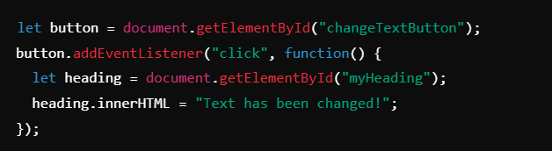
In script.js, add the following code

Slide 28
Task 2 - Change Styles Dynamically

Slide 29

Add an HTML element with an ID

Slide 30
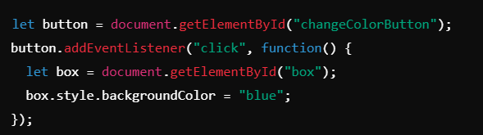
In script.js, add the following code

Slide 31
Task 3 - User Input Handling

Slide 32
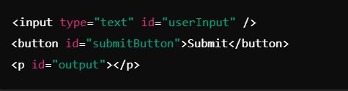
Create an input field and button in HTML

Slide 33
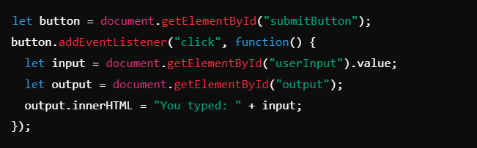
In script.js, add the following code

Slide 34
Debugging and Troubleshooting
Common Issues:
JavaScript not executing: Ensure your script is correctly linked to your HTML file.
DOM elements not found: Double-check element IDs in your HTML and JavaScript.
Solution: Use browser developer tools (Console and Inspector) to debug your JavaScript.

Slide 35
Code Review
Walkthrough: Review the solutions for all tasks.
Ensure students understand how to access and modify DOM elements and handle events.

Slide 36
Q & A Session

Slide 37
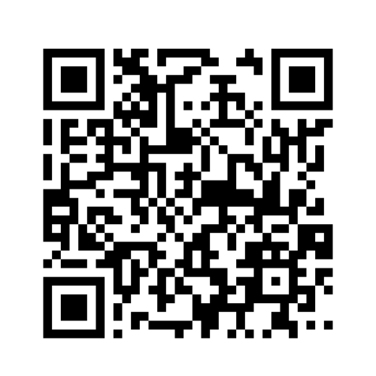
https://github.com/CODE-CRUNCH-CLUB/C8-CRUNCH-LABS-WEB-DEV

Slide 38





Attendance
Join us for the next sessions
Check our schedule on Discord “Schedule” Channel
RSVP lu.ma/CODECRUNCH
Your feedback helps us improve. Share your thoughts! Go to our website: go.fiu.edu/codecrunch
linktr.ee/CODE.CRUNCH

